Slide 1
Promenade

Slide 2
The Gnome (a dwarflike and unpleasant person)

Slide 3
Promenade

Slide 4
The Old Castle (a troubadour serenading his lady)

Slide 5
Promenade

Slide 6
Tuileries
(Children playing in the
Tuileries Park in Paris)

Slide 7
Cattle
(A Polish ox cart)

Slide 8
Promenade

Slide 9
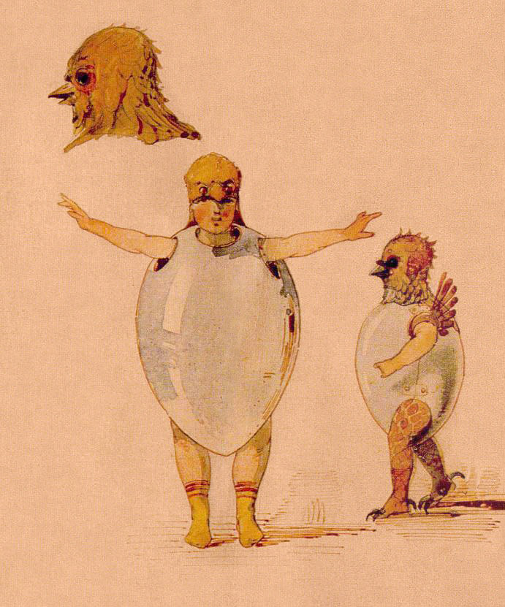
Ballet of the Chicks in their Shells

Slide 10
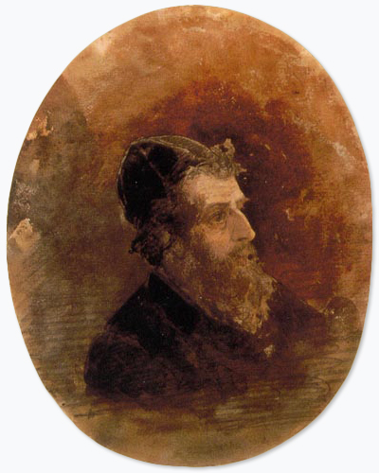
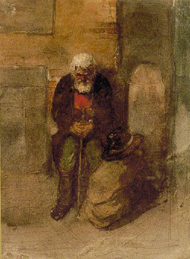
Samuel Goldenberg and Schmuyle
(Two Jews: one rich and one poor)

Slide 11
Promenade

Slide 12
The Market at Limoges
(ladies gossiping)

Slide 13
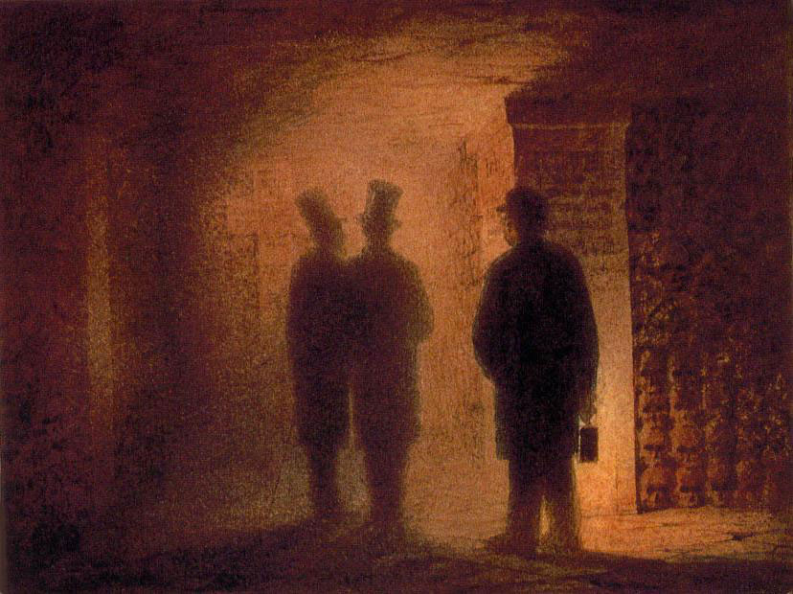
Catacombs
(Roman Tomb)

Slide 14
Promenade
(with the dead in a dead language)

Slide 15
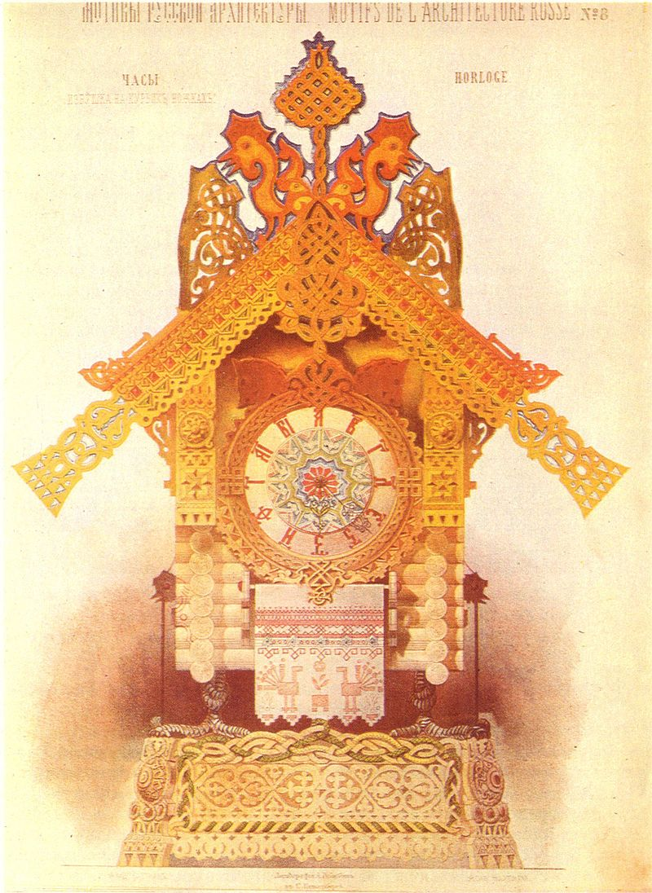
The Hut on Hen’s Legs
(Baba Yaga)

Slide 16
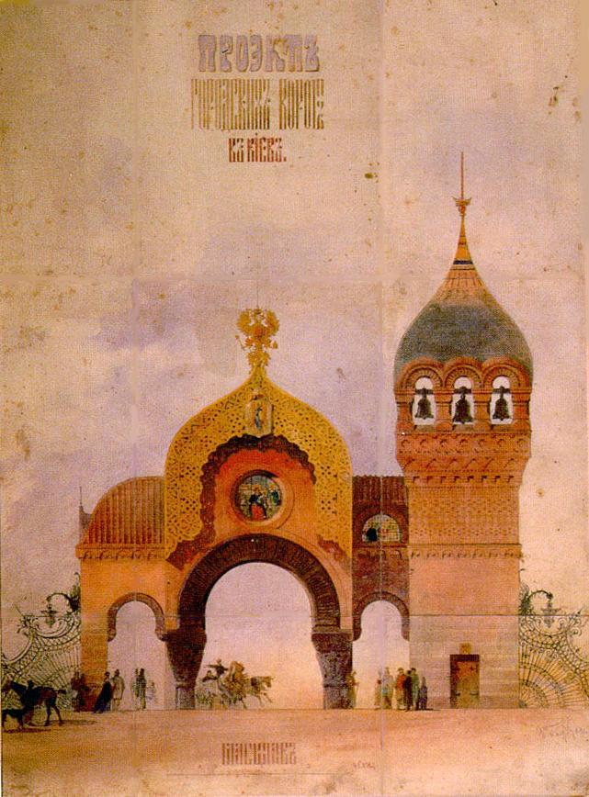
The Great Gate of Kiev

